Slide 1
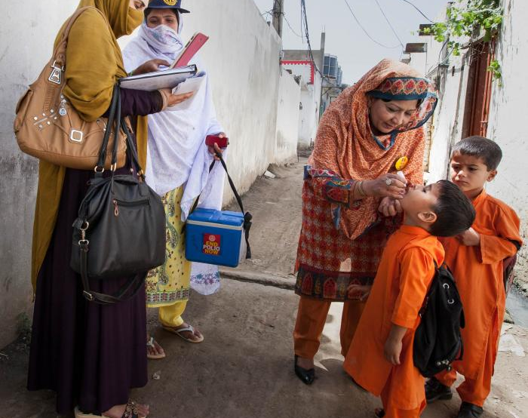
“FOOT A BILL”

Slide 2
OVERVIEW
WHO WE ARE
THE TASK
ROTARY is a community with a global network of 1.4 million people around the world
We are solving problems that affect the world
FUNDRAISING
RECRUITMENT of new Rotary Club members
AWARENESS
WHAT HAVE WE DONE
Founding member of the Global Polio Eradication Initiative in 1988.
Cases of poliovirus have significantly decreased by over 99.9% since 1988

Slide 3
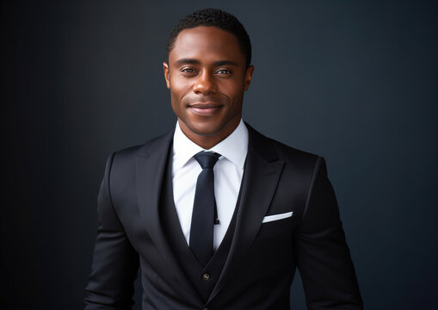
(DONORS / NEW MEMBERS)
TARGET AUDIENCE
Demographics
Male/Female, between age 18 to 45
They are gainfully employed
They live in urban areas.
Psychographics
They care about giving a helping hand where easily possible.​
Open minded and willing to support initiatives that aligns with their value
They seek fulfilment through act of service
Media Consumption
Media Consumption: TV, Radio, Digital and OOH

Slide 4
Facts
250,000
9,000
80%
Children born every year worldwide with Clubfoot
Children born in Nigeria with Clubfoot
Of Children born with clubfoot are in low and middle income Countries
Insights
Limits aspiration and dreams: People with clubfoot are sometimes turned down for jobs because employers believe they could be a liability to the company.
Misunderstanding the conditions, often leading to misconceptions and social exclusion
Our target audience are empathic, passionate about being a part of remarkable change and fighting for the right cause they believe in
Correctable in childhood, uncorrected, leads to lifetime disability

Slide 5
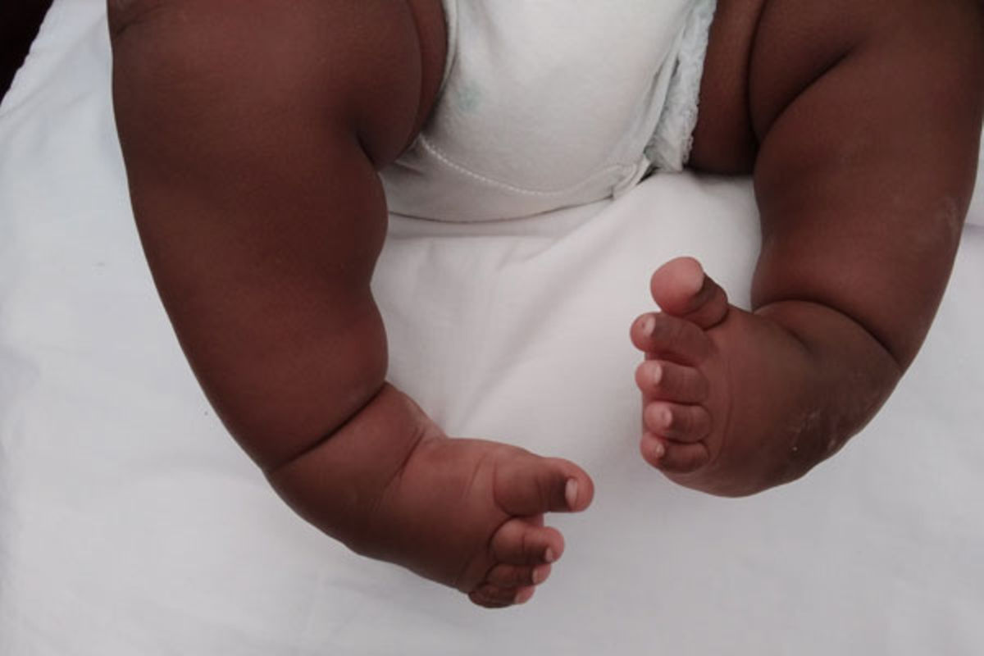
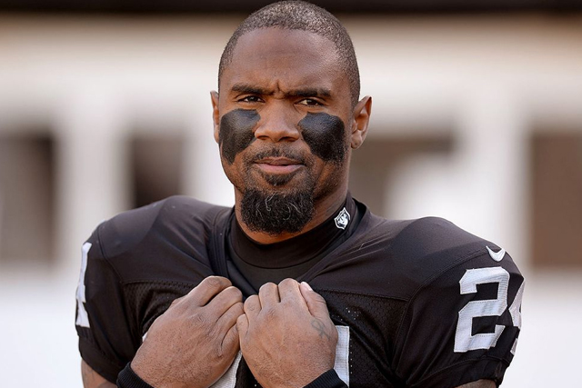
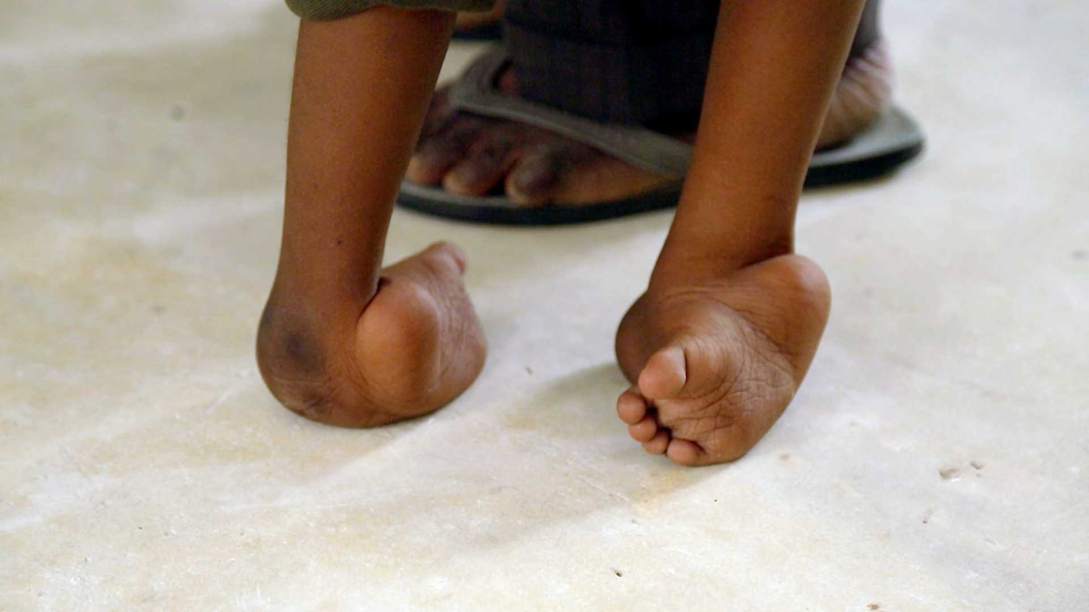
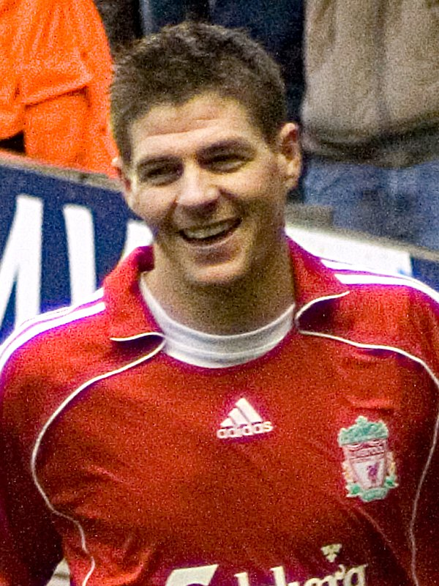
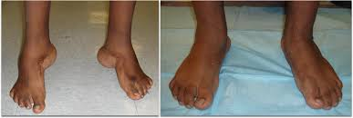
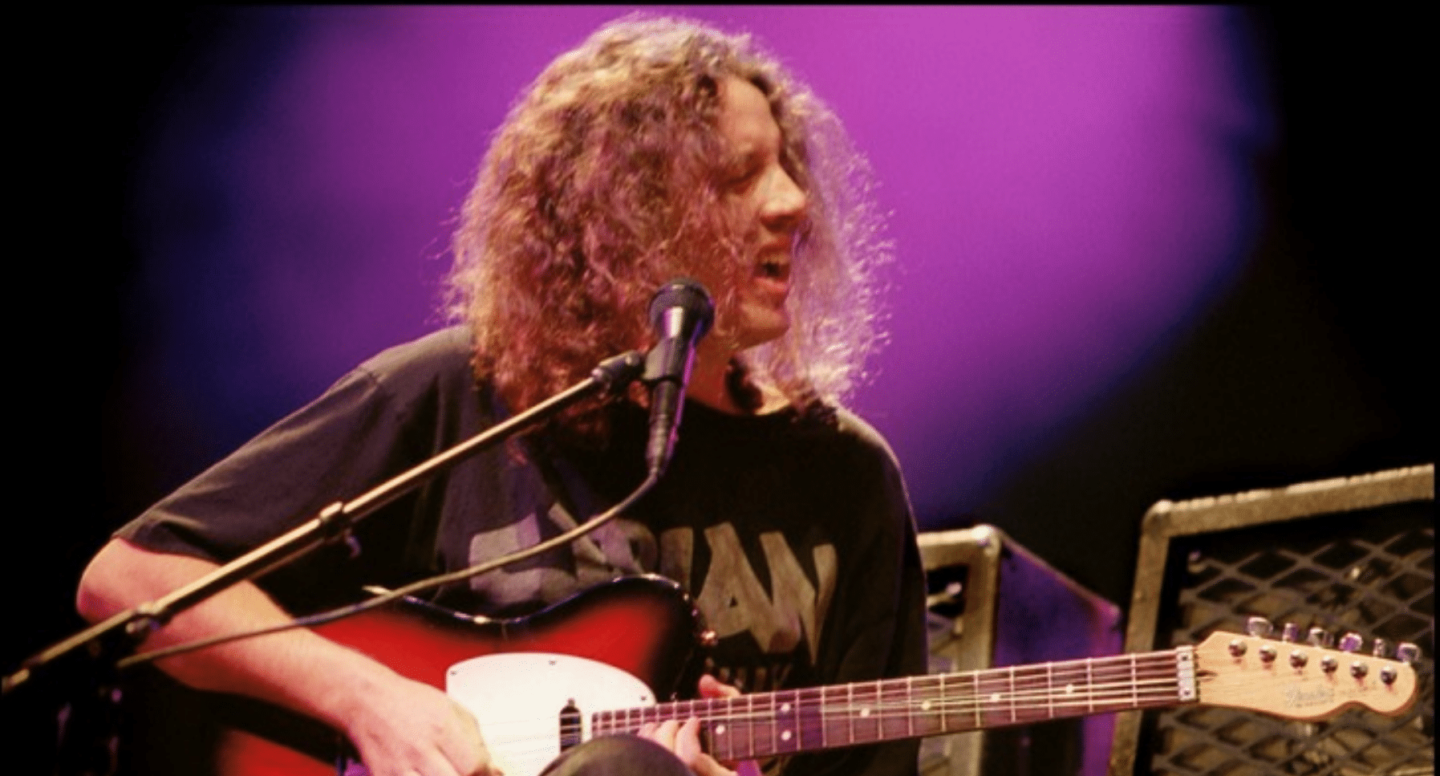
The story
These children risk facing a lifetime disability otherwise correctable in childhood due to poverty. Their dreams are shattered, and they become labeled by society.
These children have the potential to become the next Steven Gerrard, Charles Woodson, or Michael Houser, all of whom had clubfoot in childhood.
We need to provide these children with a future and early treatment. It is time to create lasting change. Rotary is ready.

Slide 6
Big Idea: FOOT a Bill
The feet are a remarkable part of the anatomy of the human body, essential for movement and progress. Inability to Foot oneself seamlessly implies a huge limitation on quality of life and actualizing ambitions.
Curating Compelling Stories
Authentic Narratives
Diverse Representation
Highlighting Impact
Interactive Engagement

Slide 7
KEY STRATEGY
ROTARY X UBER PARTNERSHIP
131 million active users, 267k in Nigeria
Over 40% of riders are middle income earners, while over 20% are high income earners
Over 75% are between age of 18 - 45 years
Revenue of $ 9.3 billion in Q3 2023.
Uber is available in around 72 countries and 10,000 cities.
Uber's CSR initiatives reflect a commitment to addressing social and environmental challenges
Source: Global web index , Statista, The Guardian

Slide 8
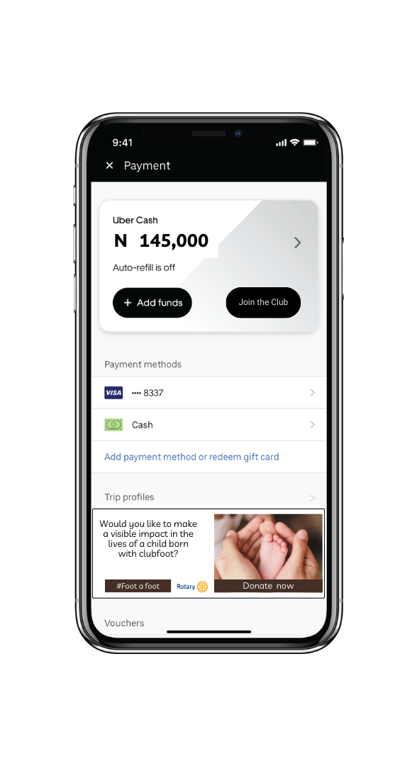
HOW WILL IT WORK - 0.1% DONATION
Donor button: Inclusion of Donor button on uber app where riders can select to donate towards care for children with clubfoot
0.1% or more: Riders receive prompt to donate 0.1 % of their trip cost or input desired amount. Money goes to Rotary International
Loyalty badges: riders earn loyalty badges for donations
Uber’s revenue Q4 ‘23:
$9,300,000,000 x 0.1% = $930,000

Slide 9
Media Strategy
AWARENESS
DRIVE ACTION
Media Partnership
Social Media
Creating engaging online visuals
Rotary Clubs
(Over 40,000)
We will partner with media outlet to promote visuals Rotary benefits from free PSAs, interview, jingles, on-air donation drives, Outdoor boards reaching a wide audience and attracting new donors and members
We will develop and execute a structured content calendar, engaging volunteer influencers, interactive campaigns, donation appeals, user-generated content, Video showcases, to deliver the messaging and drive users to utilize the uber app to donate
Feature video interview with mothers and children with childfoot to tell their stories of resilience and transformation. This will be shared across their social media platform to aid awareness among those who cares inspire them to donate and join the Rotary Club.
Utilize Rotary’s huge database of members to send out mailers and e-fliers that could be shared in their immediate community to drive even more reach
Amount Donated
Social Engagements
Number of Donors
Number of New Members
Measurement

Slide 10
SUMMARY
Our Approach:
Using storytelling to create awareness and encourage TA to join and donate
Partnership with UBER to drive donation and convert members
Partnership with influencers
Strategy media planning
Engaging content on facebook, linkedin twitter on partners platforms
Leverage wHO, UNICEF, to drive awareness
Execution
Awareness
Engagements
Conversion /Call to Action
The Goal:
Fundraising
Get more people to join the Rotary Club
Our Target:
How we will Measure
Benefactors: Men, Women 18-45, ABC.
Corporate Organizations
Prospective members
Amount Donated
No of Clicks
No of registered members
Strategy (The Idea):
FOOT A BILL

