Slide 1
Ever imagined what the world would be like without motion?

Slide 2
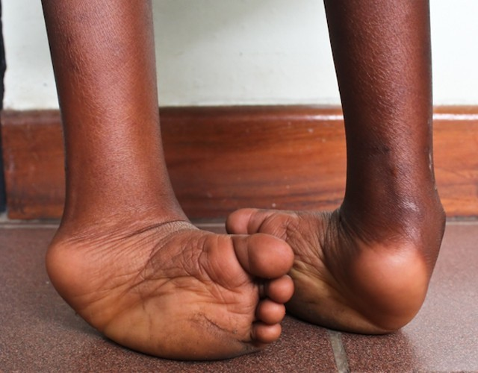
THE PROBLEM:
Painstakingly slow
Club foot is a prevalent congenital birth defect, especially in low and middle-income countries, requiring urgent attention.
Stigma
Low Self esteem
THE MAIN TASK:
We must create awareness, incite concern and Financial support for Club foot treatment and attract young professionals to join Rotary for sustainable efforts
Dark Humour
Hurtful Strides

Slide 3
Who Can Help?
For them, Success is finding satisfaction in giving a little more than they take
Every well meaning individual
Action Generators
Pace Setters
Trend Starters
Freedom is important to them. 67% will rather work from home with a slightly lower pay
Key Drivers : Success, Tech, Fashion, Fun, Sports

Slide 4
Everyone loves the ability to freely move Hence why Traffic is so annoying
Our Target audience are highly peer influenced and will hop on any well meaning trend
Humans spend 12 hours 56 minutes escaping reality each week of which Gaming and Social media takes up 9 hours +
Subway Surfers has 35 million daily active users and has been downloaded more than four billion times since launch, making it the most downloaded mobile game.
INSIGHT:
https://nypost.com/2017/07/03/americans-spend-4-years-of-their-lives-escaping-reality/

Slide 5
Latch On Their Love For Freedom and escapism to bring to fore what really matters:
OPPORTUNITY:
Harnessing the large online gaming ecosystem – where buying of second chances (extra lives) is a norm. Making it transcend the FUN to a PURPOSE. Creating an Clubfoot free Opportunity for Clubfoot patient
Fun in
My shoes
STRATEGY:
Switch to a clubfoot custom-made interface in the subway surfers game, that elucidates the hardships of the a clubfoot patient (race is slower, less tendency to catch coins and gifts, higher chance to get caught by the police). Thereby giving the players a snippet into the frustration and day in life of a clubfoot patient to derive empathy and support.

Slide 6
Activation Mechanics
Programmatic new challenge notification pop-up as you
open your Subway Surfers app and as a gamer that uses the app even without opening the app
Season Challenge : Fun in my Foot club shoes
Empathy driven visual augmented by Call to Action to incite engagement
Extra lives & special skills purchase, of which funds will be diverted to Rotary for clubfoot children
Recognition Badge for “Playing in my clubfoot shoe” in the subway suffers Community
Automatic share to Facebook with friend to join in the challenge

Slide 7
Launch using owned assets and Key Ambassadors on World Clubfoot Day
Leveraging Partner assets
Subway Suffers community for awareness
Programmatic pop ups to reach other online gamers and thereby incite action
Digital Posts and public sensitization

Slide 8
EXPECTED RESULTS
For a ONE-month activation to launch in June We anticipate
About $600k daily revenue generation, with 10% to be diverted to the Rotary Club for Club foot Patient
20% increase in user-engagement
Over 10m combined earned impressions across social media and traditional media
Congratulations you have just helped
Helped 3 Clubfoot Children!!!!

Slide 9
Fun in My Shoes
Every clubfoot child deserves an Opportunity to have their condition reversed, Now you can help whilst still having fun
WHY WE LOVE THIS IDEA
It is an innovative way to drive awareness towards the Clubfoot Condition
It is a fun way of showing support and concern with a purpose and without losing any cost beyond regular gamming expenses/experiences
It is a WIN for ALL : Clubfoot-Children get reversal opportunity, Subway Surfers gets mileage and User- engagement, and Online Gamers Community get satisfaction of doing a GOOD deed and a Global Recognition Badge from the Subway Suffers Team
Leveraging the Subway Suffer Community, has the potential to garner Earned Media
It is a cost-effective initiative

Slide 10
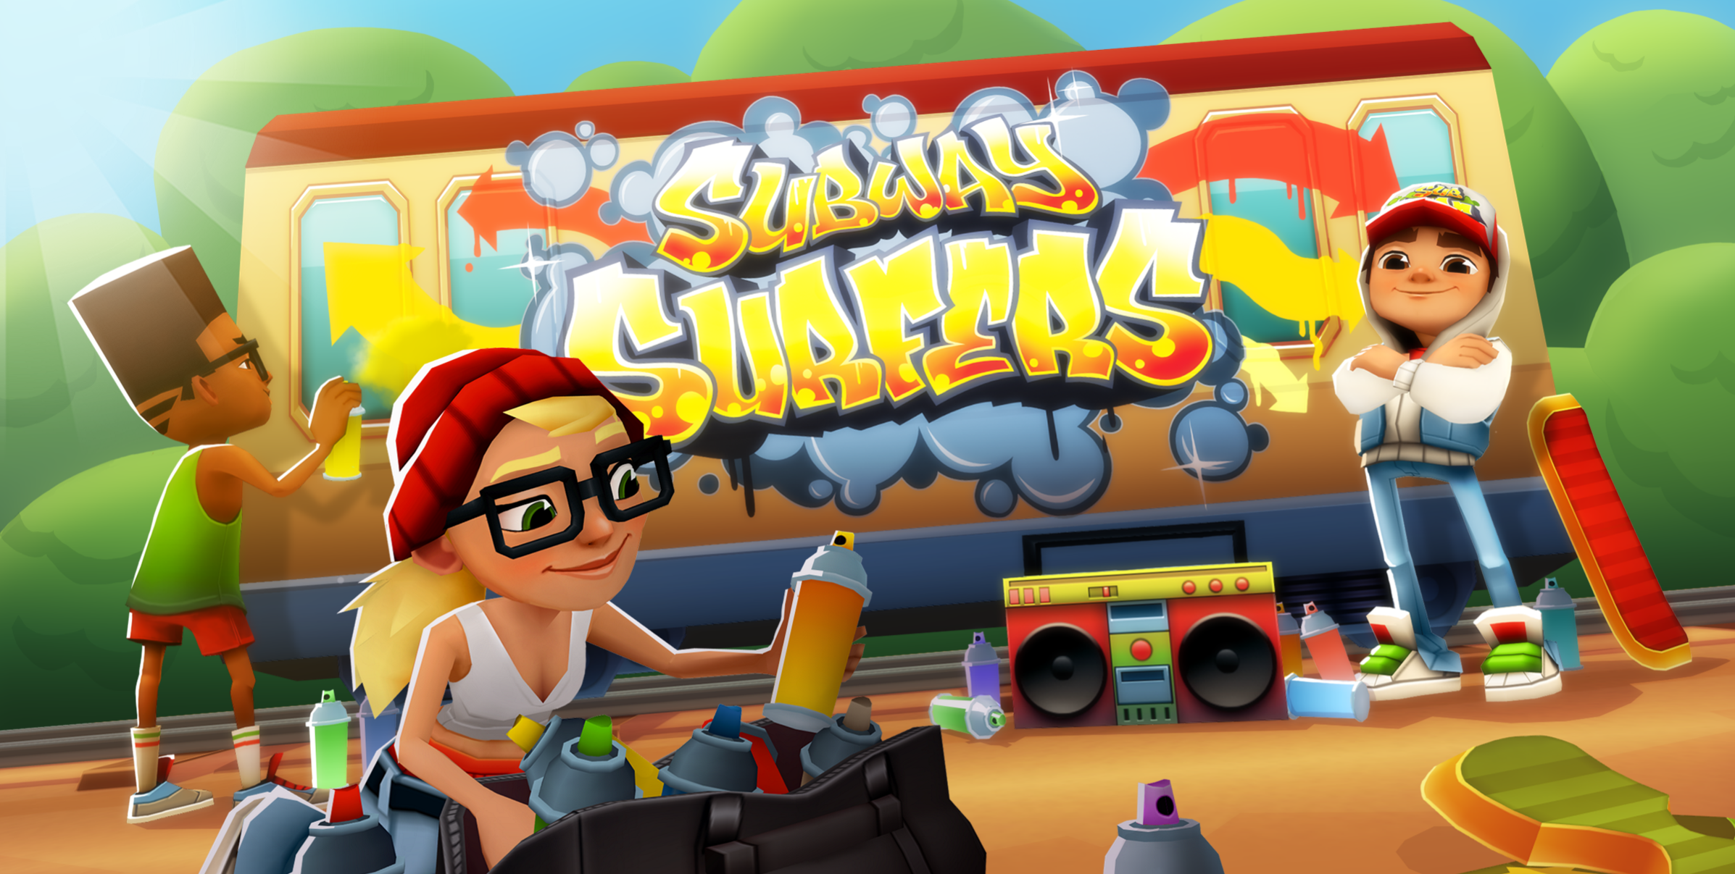
SUMMARY
INSIGHT:
Everyone loves their freedom and some form of escapism
Subway Suffers generated $155 million in 2023 from special skills and extra lives purchase
OPPORTUNITY:
Harnessing the large online gaming ecosystem – where buying of second chances (extra lives) is a norm. Making it transcend the FUN to a PURPOSE. Creating a Clubfoot reversal Opportunity for Children with Clubfoot
Fun in My Shoes
Every clubfoot child deserves an Opportunity to have their condition reversed, Now you can help whilst still having fun
STRATEGY:
Integrate a custom-made level in the Subway surfers, that elucidates the hardships of the a clubfoot patient (race is slower, less tendency to catch coins and gifts, higher chance to be caught by the police). Thereby giving the players a snippet into the frustration and day in life of a clubfoot patient to derive empathy and support.

