Slide 1
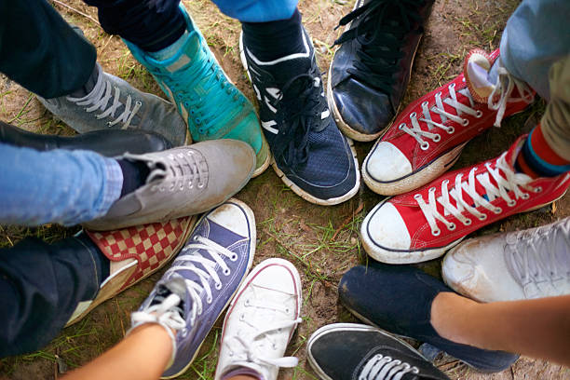

Slide 2
BRIEF IN BRIEF
Key Challenge:
Beyond donations, there is so much more that can be done to make amputees life more comfortable especially in public spaces. This can be achieved by making our homes and places open to the public more accessible to amputees.
Task at Hand:
Having this in mind, we are tasked with sensitizing people on the plights suffered by amputees with an end goal of societal change.
Raise awareness of the walk scheduled by the Feet of Grace Foundation.

Slide 3
COMMUNICATION OBJECTIVES
1
2
3
Raise funds through the Hit The Street 2023 walk to aid in making life better for the amputees.
Brand awareness and pushing people towards a more comfortable society for amputees.
Awareness / Consideration / Conversion
Reach: 70%-80%
Frequency 1+
*Budget Dependant
Final Budget TBC
Business Objective
Marketing Objective
Media
Objective

Slide 4
THE HUMAN NARRATIVE
Culturally Speaking……..
“I believe in inclusivity. Everyone should have an opportunity to become who they want in life despite of their limitations. Disabled people should access equal opportunities like everyone”
“Amputees are very strong and courageous people. It is not easy living with a disability. Caring for people with disabilities usually takes a toll on their care-givers. It drains them both financially and mentally. It is our responsibility to take care of the amputees in our society. We should make the world a better place for them.”
”I usually donate to foundations or participatein charity events that target people living with disabilities. It is good to help people the less fortunate in the society
“It saddens me to see amputees struggle to get around. The government should provide wheelchairs and crutches for them. It is their responsibility to take care of disabled people in the society.”

Slide 5
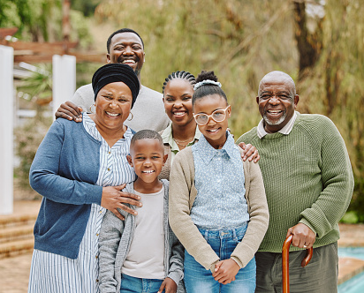
THE BIG QUESTION
HOW DO WE GET OUR AUDIENCES TO CREATE A SOCIETY THAT IS MORE COMFORTABLE TOWARDS AMPUTEES?

Slide 6
TARGET AUDIENCE
DONORS
CHARACTERISTICS
NEEDS & MOTIVATIONS
Individuals or organizations that pride themselves in giving or donating money, property or services.
The key motivation for donors is to be associated with the foundation that they are raising funds towards.
They have a mandate to meet sustainability targets and maintain the companies reputation
DECISION MAKERS
CHARACTERISTICS
NEEDS & MOTIVATIONS
Decision-makers in various corporations have a high level of influence and control over their organization's financial and operational decisions.
Provide large donations to be philanthropic.
They expect several marketing opportunities from their donation, for example Naming a building or a hall after them or announcing their gift in a major press release.

Slide 7
CONSUMER JOURNEY
AWARENESS
CONSIDERATION
CONVERSION
Consumer Mindset
CARING FOR DISABLED PEOPLE IN THE COMMUNITY IS THE WAY TO GO
NOT ONLY SUPPORTING DISABLED PEOPLE FINANCIALLY BUT ALSO TAKING CARE OF THEM
LOYAL TO THE CAUSE AND ARE READY TO GET OTHER PEOPLE ON BOARD
Build and maintain TOMA
Engaging messaging
Stand out, competitive positioning
High reach touchpoints + frequency
Build trust
Position as forward thinking and people-forward
Demonstrate empathy
Show understanding of personalised needs
Solidify concrete reputation
Consistent engaging messaging
Show more opportunities of engaging amputees
Success stories
Media Role
Channels
RADIO ADS
TV FEATURES,
DOOH
RADIO ADS CONVERSATIONS
TV ADS,
OOH
SOCIAL MEDIA
SOCIAL MEDIA
NEWSPAPER
SOCIAL MEDIA
ARTICLES

Slide 8
INTERNAL GUIDING THEME
CONSUMER TRUTH
BRAND TRUTH
Consumers are looking for a way to be more social impactful in life. They are in search of a partner and not just a platform or a foundation. An organization that they can walk with on their journey.
.
Transforms people’s lives by giving messages of and raising funds to provide wheel chairs, prosthetic limbs and other services to amputees.
LEAPFROG FROM MAKING DONATIONS TO CREATING AN EXPERIENCE EMBEDDED IN PERSONALISED CONNECTION WITH AMPUTEES:
ENCOURAGE AND EMPOWER EMPATHY
The category is considerably predictable, presenting multiple windows of opportunity within media, primarily linked to social media, influencers, TV, radio, OOH and experiential in-store. Feet of Grace Foundation needs to amplify it’s leadership position by pioneering within these
high-potential gaps.
CATEGORY TRUTH

Slide 9
UNPACKING THE INTERNAL GUIDING THEME
The guiding theme speaks to encouraging & empowering empathy in three ways:
APPLICATION TO MEDIA
Encouraging our audience to be more caring around amputees in a move to humanize them. People should see them as equals.
Encouraging our audiences’ spirit of empathy in the activities they undertake day to day.
Explorative and evolutionary approach to media by taking on an innovative multi-channel approach
Our media exposure will focus on our target audiences passions and interests such as entertainment, charity, music contents etc.
Demonstration of how we can apply our theme “towards a society more comfortable with amputees” as a guide to our daily life.
Our media needs to be interlinked so as to maintain audience attention across their conversion journey i.e. a CTA on OOH prompting action on social etc.
In the spirit of empathy, media execution should portray a variety of formats in order to appeal to a wider audience base
INNOVATION

Slide 10
THANK YOU!

