Slide 1
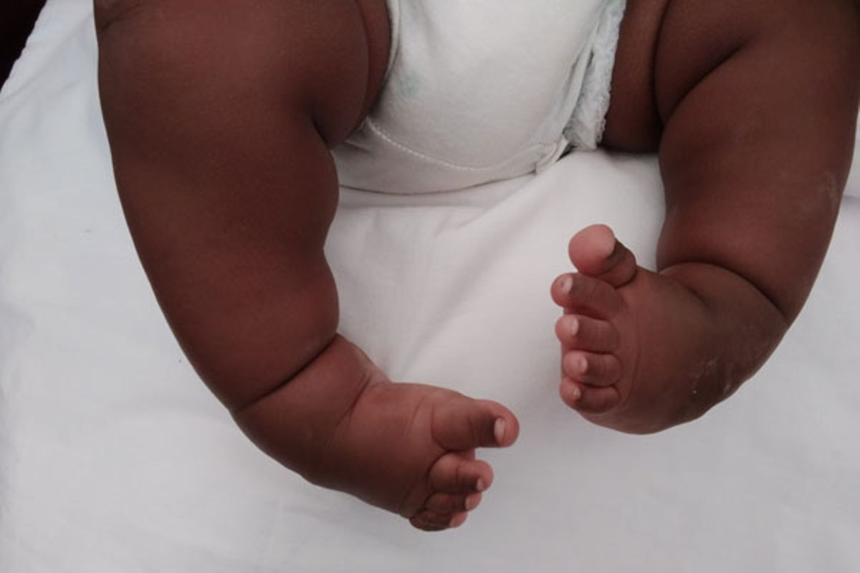
99.9% Chance
We did before, We can do it again!!!

Slide 2
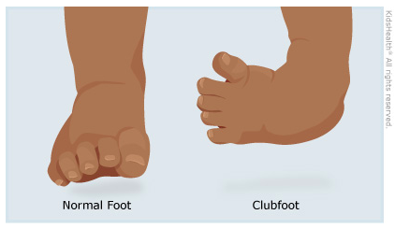
We have identified some of our strength, weaknesses, opportunities, and threats.
Strength- People are more endeared to children, hence, our cause well positioned.
Weaknesses- Low income, Emotional disconnect, lack of trust in the process, have been identified as weaknesses.
Opportunity- Avenue to give back to the society through a notable cause using a well established organization(Rotary)
Threats- Economic Factors, Zero tax break, Competing Needs
The Problem
According to the Nigeria Health Watch nearly 250,000 newborns every year globally has the clubfoot defects
Over 80% of global annual prevalence occurs in low-income countries
In Nigeria,9,000 children are born with the defect clubfoot yearly
However…
‹#›
Our Task
To Create awareness about the club foot defect.
Trigger realization among meaningful individuals who ‘care’ to donate.
Create engagement among our TG leading to donations and show intent of joining Rotary

Slide 3
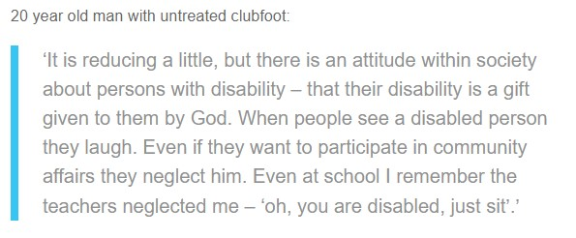
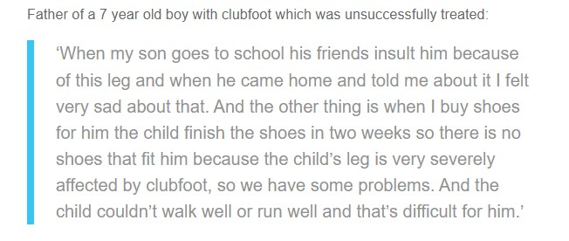
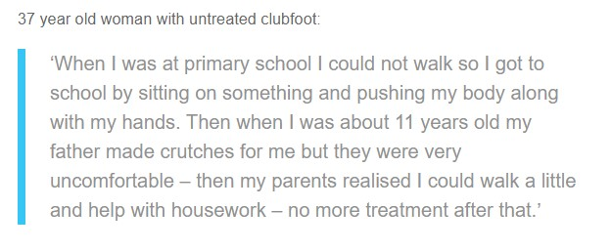
The Challenges
Some believe clubfoot is caused by supernatural forces, leading to fear and social stigma for affected families
Families fear that their child may be ostracized or excluded due to clubfoot, leading them to isolate themselves.
Lack of awareness about effective treatment options like the Ponseti method can lead to feelings of hopelessness..
“Together, we see a world where people unite and take action to create lasting change - across the globe, in our communities, and in ourselves”

Slide 4
The Audience
There’s a 99.9% Chance
KEY DEMOGRAPHICS
Age- 18 years – 45 years
Gender- Male and Female
Occupation: Working class, Self-employed, Business Owners & High Net Worth Individuals
Geographic Location: Global, with a focus on LMICs (Low or Middle-Income Countries) where clubfoot prevalence is higher
BEHAVIOURS
Willingness to participate in fundraising events and campaigns
Regular involvement in community-based organizations
KEY PSYCHOGRAPHICS
Compassionate and socially conscious individuals
Strong sense of empathy and desire to help those in need
Supporters of humanitarian causes and initiatives
PREFERRED CHANNELS
Radio during drive time
TV at night and on weekends
Online(Social Media) visits during every free time
Events and Social Gatherings
PREFERRED CONTENT TYPE
Movies
Sports
Music and Entertainment
News
N E W P R O D U C T L A U N C H

Slide 5
There’s a 99.9% Chance…
INSIGHTS
OUR BIG IDEA
Misconceptions and social stigma can cause emotional distress for families.
Storytelling has proven to be an attention thief in a society with about 3 seconds attention span.
Lack of awareness about treatment options can lead to delayed intervention, potentially impacting long-term outcomes.
Individuals are discouraged from donation where they do not have details that depicts transparency.
99.9% Chance
The 99.9% success of Rotary Club’s campaign against polio serves as a powerful precedent, demonstrating the organization's capability to drive impactful change on a global scale.
We are leveraging on this success that significantly eradicated cases of polio by 99.9% to establish trust and confidence as we aim for a "99.9% chance to eradicate" Clubfoot untreated cases
We will build on credibility, set ambitious yet achievable goal, and foster empathy through the potential impact on children's lives.
“Together, we see a world where people unite and take action to create lasting change - across the globe, in our communities, and in ourselves”
‹#›

Slide 6
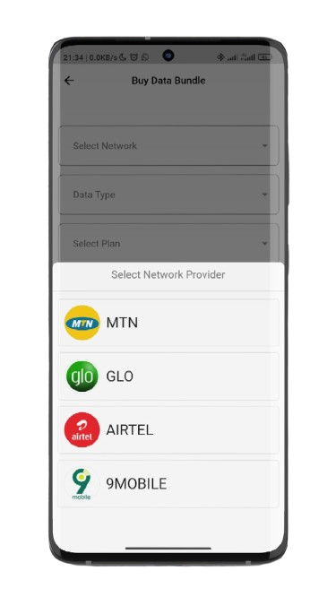
KEY STRATEGY
ROTARY X TELECOMMUNICATIONS COMPANIES PARTNERSHIP
WHY
Total amount spent on airtime daily- 11.81bn
3 million Nigerians recharge their phone every hour
HOW
We can raise fund by partnering with telcos to offer 99.9kobo seamless micro-donations through bank apps during airtime or data purchases.
Frame the micro-donations within the context of the "99.9% Chance" theme highlighting how even small contributions can collectively add up and make a significant difference.
‘’Small Change, Big Impact: Donate 99.9kobo Today for a 99.9% Chance to curb Walk”
0.99kobo * 3,000,000 = 2,970,000 million naira hour
0.99kobo *72,000,000 =71,280,000 million per day

Slide 7
99.9% Chance Media Strategy
02
04
Documentary of Successful clubfoot treatment named - 99.9% reasons for people to take action
This documentary would shine a light on the transformative journey of individuals who have overcome clubfoot through timely and effective treatment.
Online Campaign
Social Media Challenges
Leveraging on the 11.4 million rotary Clubs
Leveraging WHO and UNICEF Online Platforms to push contents and drive awareness
01
03
05
Utilize TV, Radio & Out of Home partnerships to drive reach and awareness of the causes, the route to treatment and donation avenue
Partnership with Telecoms to drive awareness of the campaign and donations via SMS, Ringback Tunes and
Feature campaign on their Mobile Apps
Join Rotary Club
Utilize All campaigns to drive sign ups and invite people to join Rotary Club
Organize a Foothaton
Challenge where people have to showcase themselves walking a particular distance or not being able to use both their legs. #99.9 #foothaton

Slide 8
Measurement
Amount Donated
Interactions Achieved
Partnerships Achieved
Number of Members Joined

Slide 9
SUMMARY
Challenge: Create awareness about the club foot defect.
Trigger realization among meaningful individuals who ‘care’ to donate.
Create engagement among our TG leading to donations and show intent of joining Rotary
Strategy: Partnership with telecommunications
Radio and TV ulization
Documentary
Footahon
Results : over 72m funds will be raised,
5000 Members Joined
There’s a 99.9% Chance

Slide 10
THANK YOU
Thank You

